Slide 1
Human resources slide 1
HUMAN RIGHTS
.

Slide 2
Human resources slide 2
CONTENT
WHAT IS HUMAN RIGNTS
HISTORY AND CAUSE OF HUMAN RIGHTS
NEEDS OF HUMAN RIGHTS
TODAY CONDITION OF HUMAN RIGHTS
CONCLUSION
Blogs

Slide 3
Human resources slide 1
WHAT IS HUMAN RIGHTS
The rights you have simply because you are human , these rights are the only rights which applied to everyone, everywhere , that means kids, old people, young people, poor people , sports man, garbage man, teacher, Africans, Indians, Albanians, Christians, Muslims, your mom and dad , next to your neighbor and you have the exact same human rights
The Universal Declaration of Human Rights (UDHR), adopted by the UN General Assembly in 1948, was the first legal document to set out the fundamental human rights to be universally protected. The UDHR, which turned 70 in 2018, continues to be the foundation of all international human rights law. Its 30 articles provide the principles and building blocks of current and future human rights conventions, treaties and other legal instruments.
The UDHR, together with the 2 covenants - the International Covenant for Civil and Political Rights, and the International Covenant for Economic, Social and Cultural Rights - make up the International Bill of Rights.
.

Slide 4

Human resources slide 8
HISTORY OF RIGHTS HUMAN
Its roots lie in earlier tradition and documents of many cultures.
The origins of Human Rights are ideally pinpointed to the year 539 BC. When the troops of Cyrus the Great conquered Babylon. Cyrus freed the slaves, declared that all people had the right to choose their own religion, and established racial equality.
These and other principles were recorded on a baked-clay cylinder known as the Cyrus Cylinder, whose provisions served as inspiration for the first four Articles of the Universal Declaration of Human Rights.
The expression human rights is relatively new, having come into everyday parlance only since World War II, the founding of the United Nations in 1945, and the adoption by the UN General Assembly of the Universal Declaration of Human Rights in 1948.

Slide 5

Human resources slide 7
CAUSES OF HUMAN RESOURCES
These causes have to do with underdevelopment, economic pressures, various social problems, and international conditions. Indeed, the roots of repression, discrimination, and other denials of human rights stem from deeper and more complex political, social, and economic problems.

Slide 6
Human resources slide 6
WHY DO WE NEEDS OF HUMAN Rights
Human rights offer us safety, freedom and protection. Here’s ten reasons why we NEED human rights legislation, courts, lawyers and campaigners. Of course, there are hundreds of thousands of reasons and cases but here’s a few to get us going .
1. Slavery, human trafficking and sexual exploitation
2. Violations against freedom of speech, expression, assembly and association
3. Torture, arbitrary arrest, detention or exile and restrictions against freedom of movement

Slide 7
Human resources slide 7
Todays Condition Of Human Rights
But a little problem arises , if people have the right to food and shelter why are more than 16,000 children dying of starvation everyday ,if people have freedom of speech why are thousand in prison for speaking there mind if people have right of education why there are billion adults unable to read.

Slide 8
Human resources slide 6
Freedom House Report
Freedom House is the oldest American organization devoted to the support and defense of democracy around the world. It was formally established in New York in 1941 to promote American involvement in World War II and the fight against fascism.
From the latest report of Freedom house where they calculated the freedom score of 195 countries, the average score is going lower

Slide 9
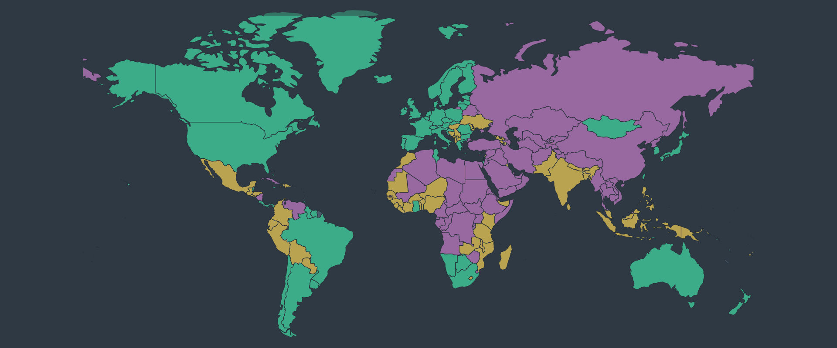
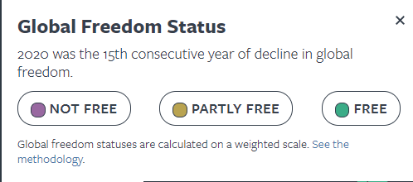

Slide 10
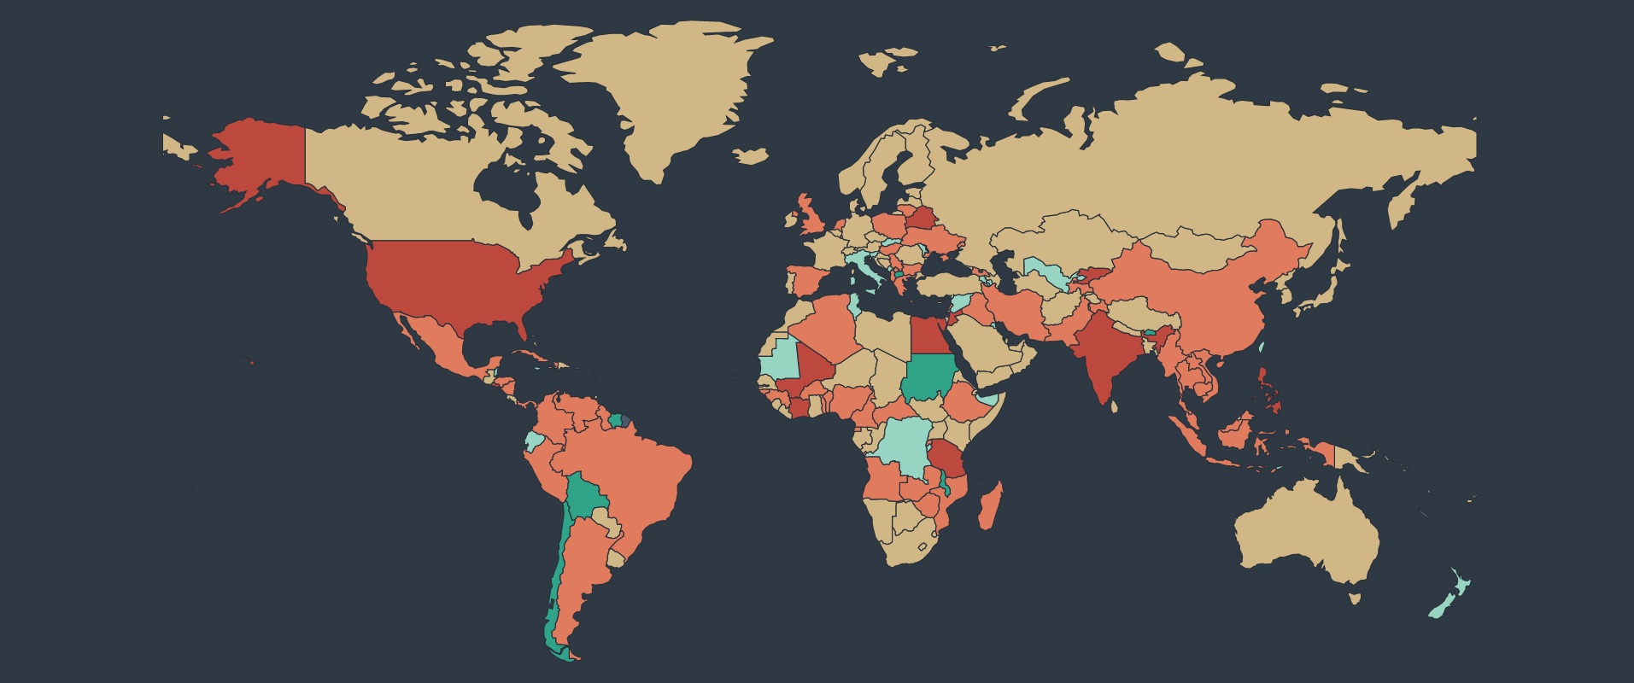
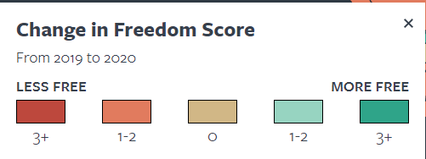

Slide 11
Human resources slide 8
CONCLUSION
People who fight against discrimination and poverty are not giants or superhero they are people, who realize that human rights are not history lesson they are not words on page not speeches or commercials they are the choices we make every day as human beings they are the responsibility we all share to respect each other to help each other and to protect those in need as Eleanor Roosevelt said we’re after all the universal human rights begin in small places close town so close is so small but they cannot be seen on any maps of the world yet they are the world of individual person the neighborhood who live in the school or college he attends the factory farm or office he generally work these are the places where every man, women and child seeks equal justice , equal opportunity , equal dignity without discrimination Unless these rights have meaning there they have little meaning anywhere

Slide 12
Human resources slide 1
Thank you
.

